Slide 1

GROUP 2

Slide 2

Group 2 Member
Hoang Gia Huy
Tran Nhat Linh
Nguyen Anh Quan
Doan Duc Do
Nguyen Anh Minh

Slide 3
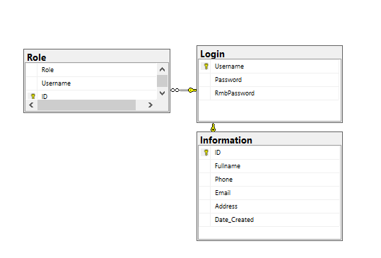
DATABASE
HOANG GIA HUY

Slide 4
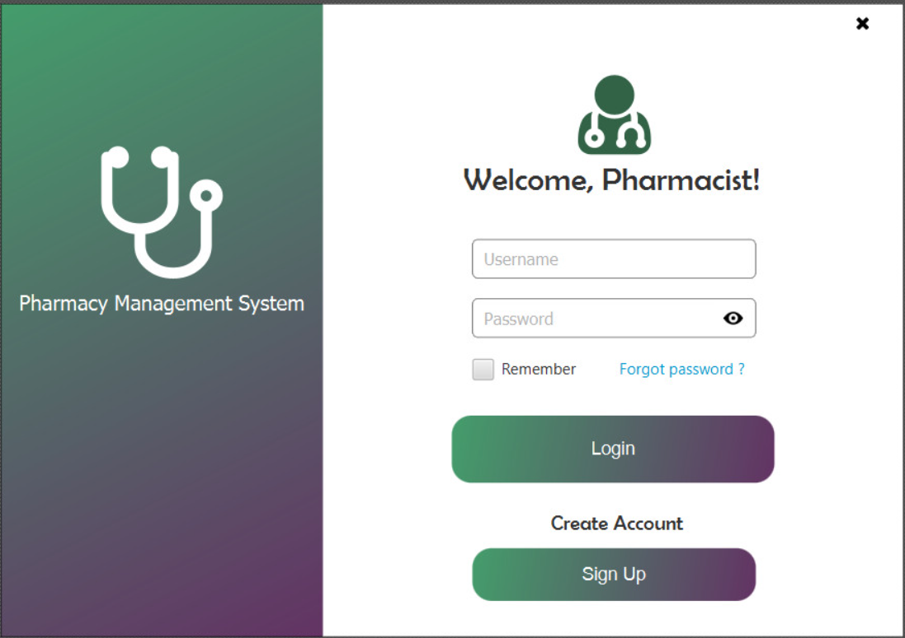
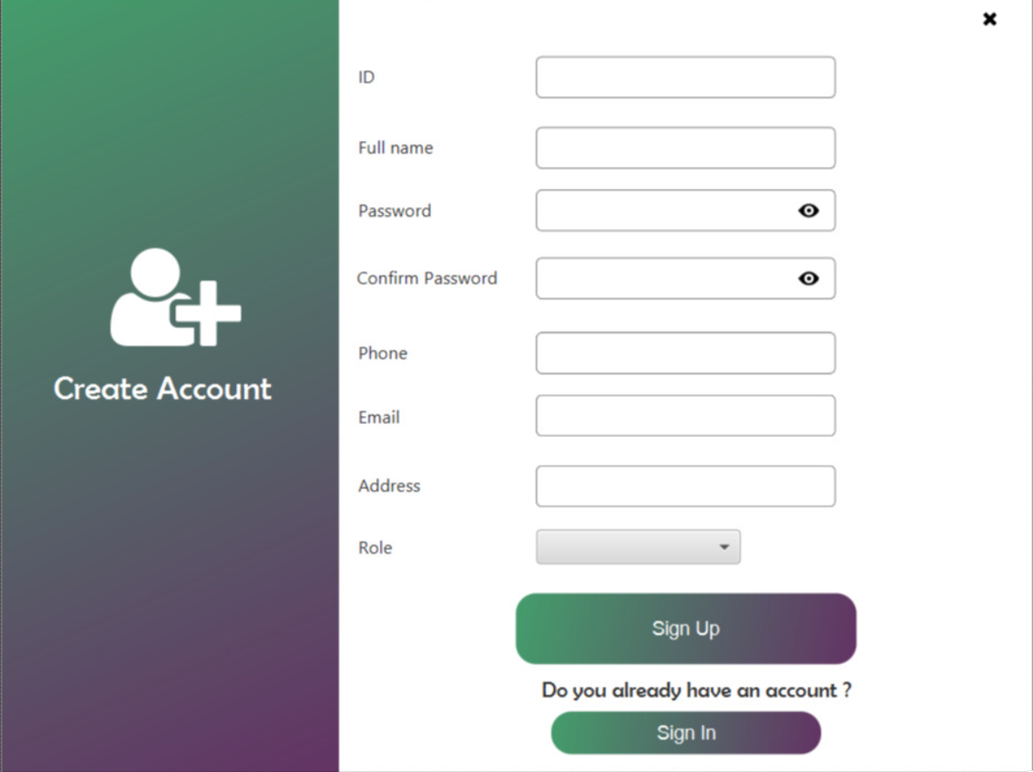
HOANG GIA HUY
Sign Up, Sign In

Slide 5
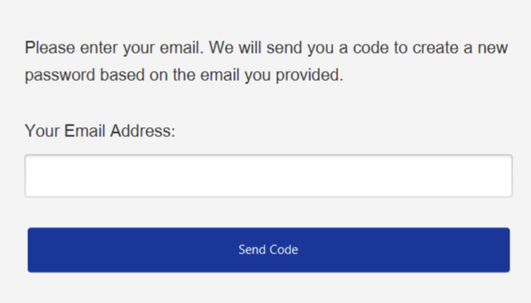
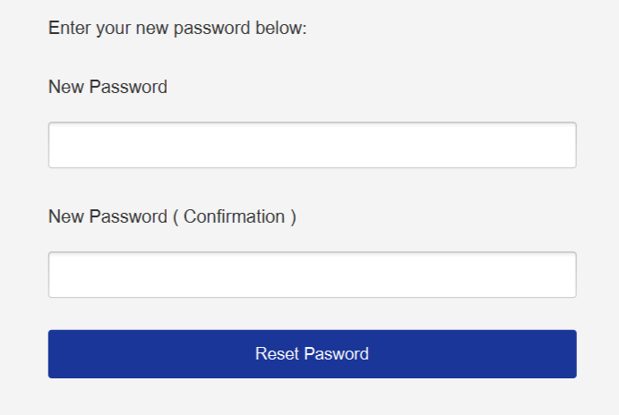
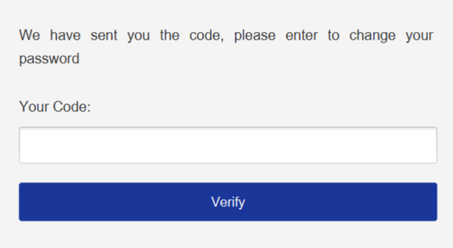
HOANG GIA HUY
Forgot Password, Verify, Reset Password

Slide 6
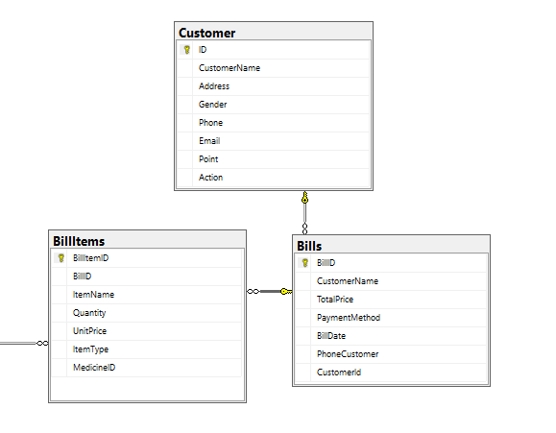
TRAN NHAT LINH
DATABASE

Slide 7
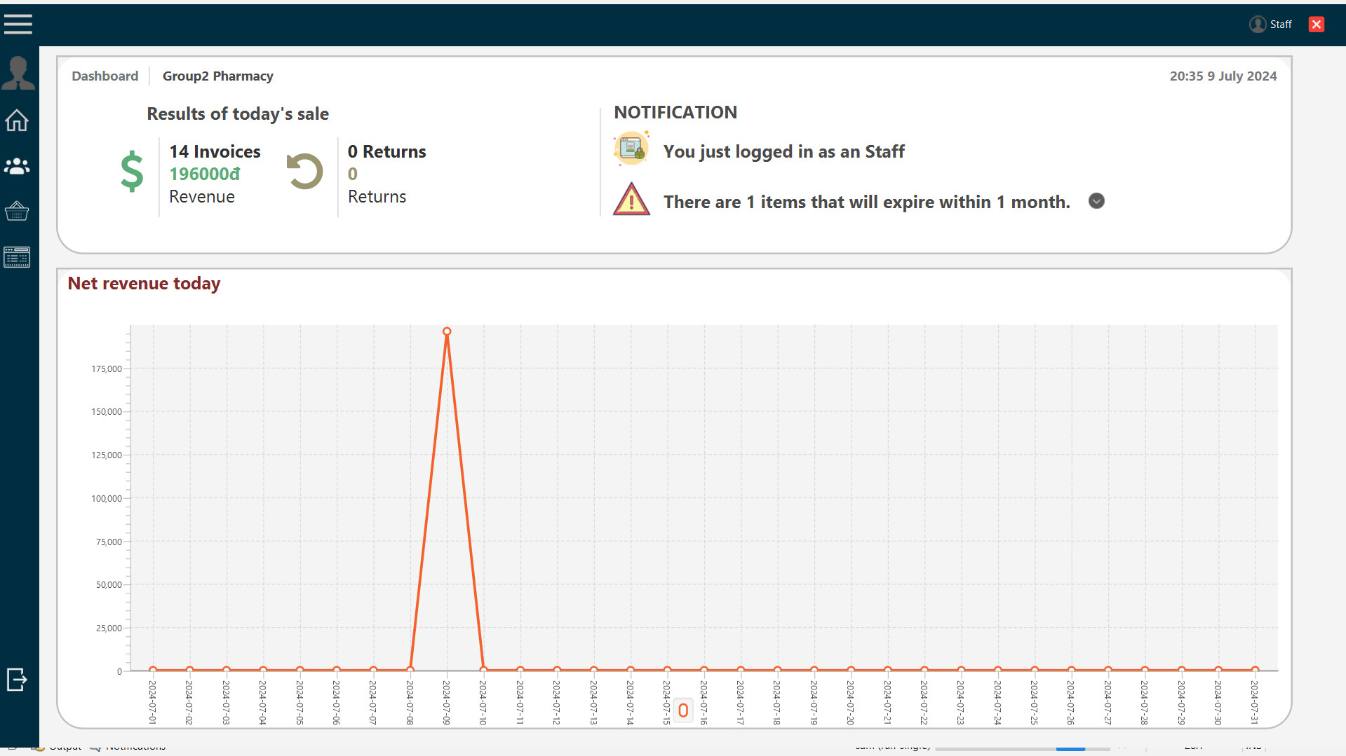
TRAN NHAT LINH
DASHBOARD FOR STAFF

Slide 8

TRAN NHAT LINH
DASHBOARD FOR MANAGER

Slide 9
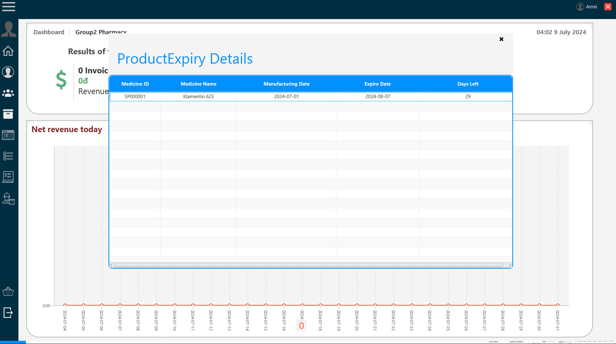
TRAN NHAT LINH
DASHBOARD

Slide 10
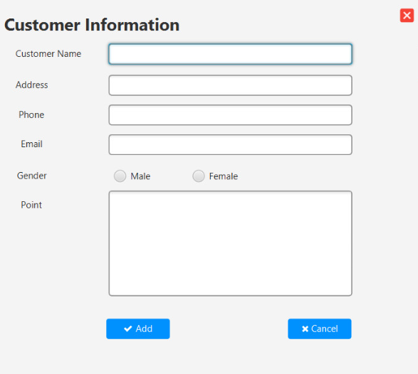
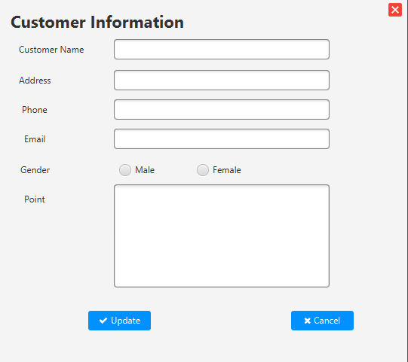
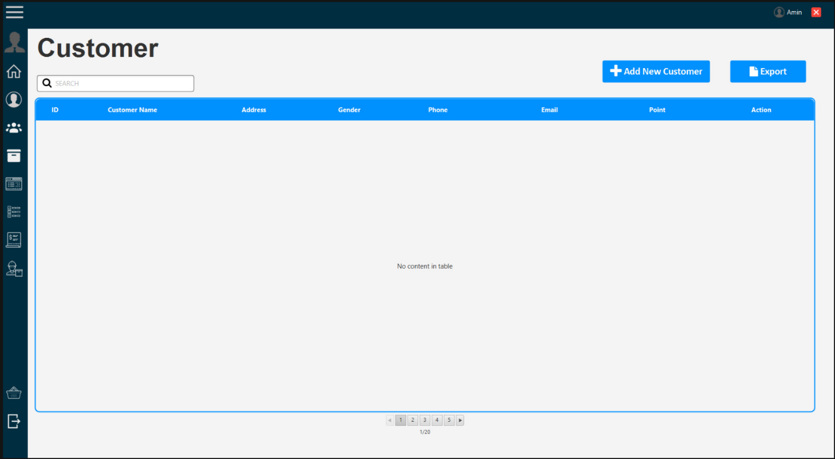
TRAN NHAT LINH
CUSTOMER

Slide 11
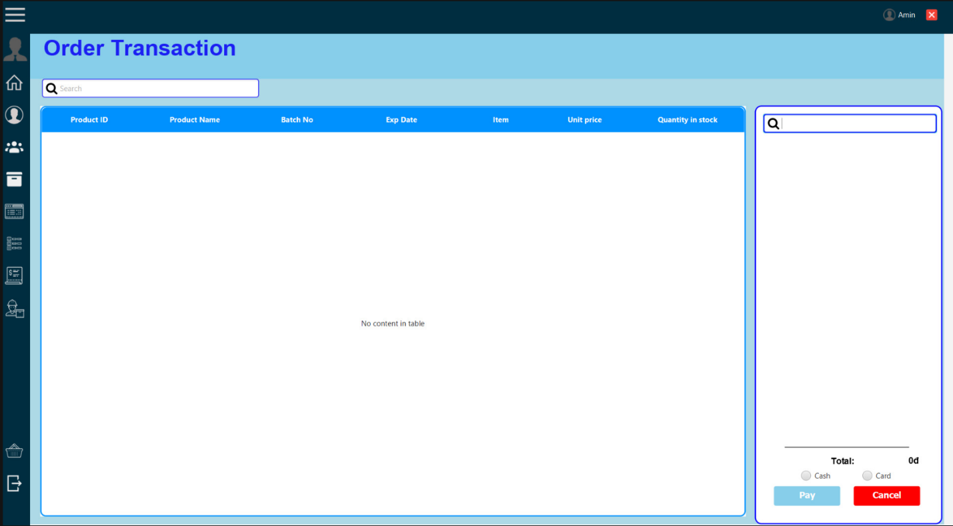
TRAN NHAT LINH
ORDER TRANSACTION

Slide 12
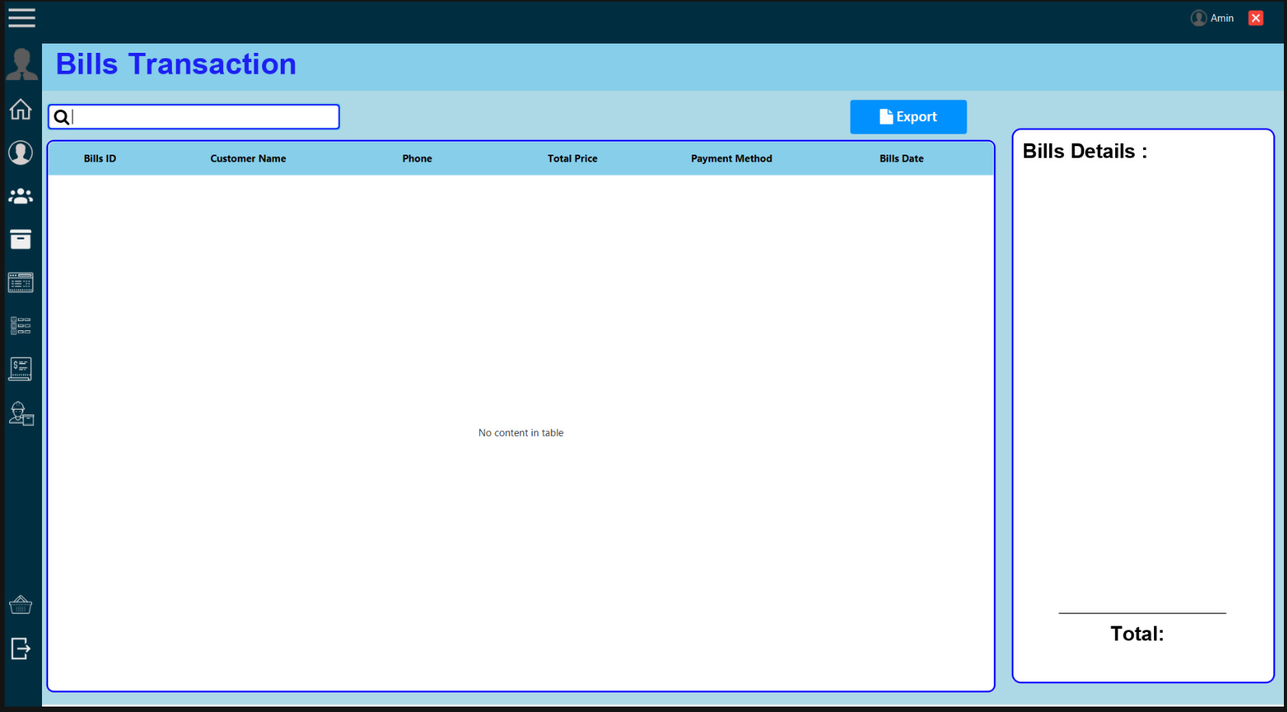
TRAN NHAT LINH
BILLS TRANSACTION

Slide 13
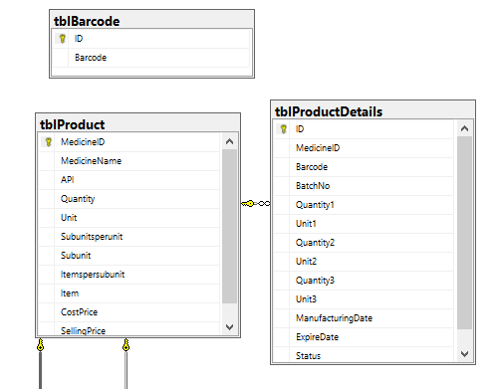
NGUYEN ANH MINH
DATABASE

Slide 14
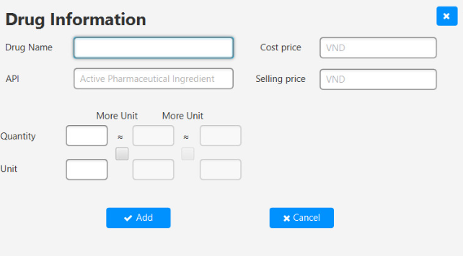
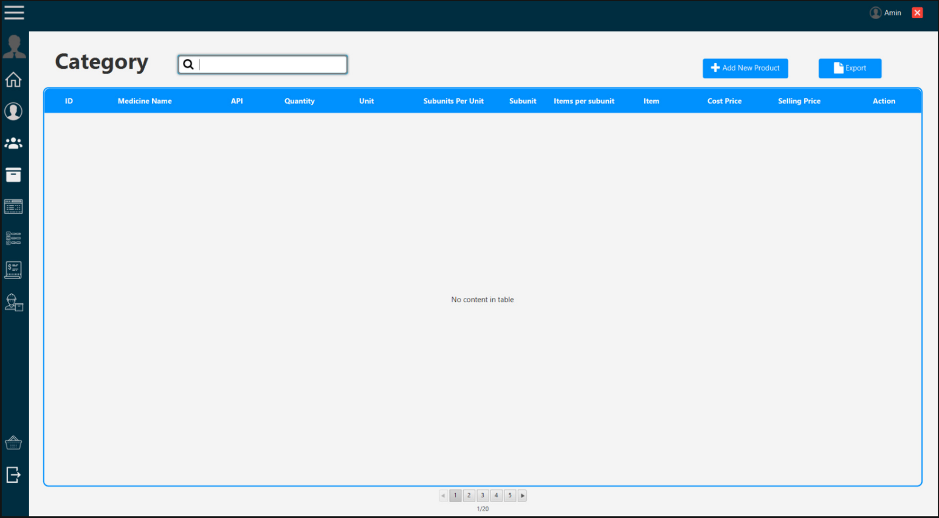
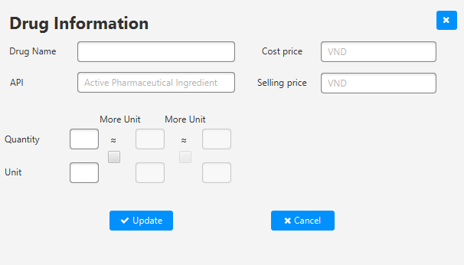
NGUYEN ANH MINH
DRUGLIST

Slide 15
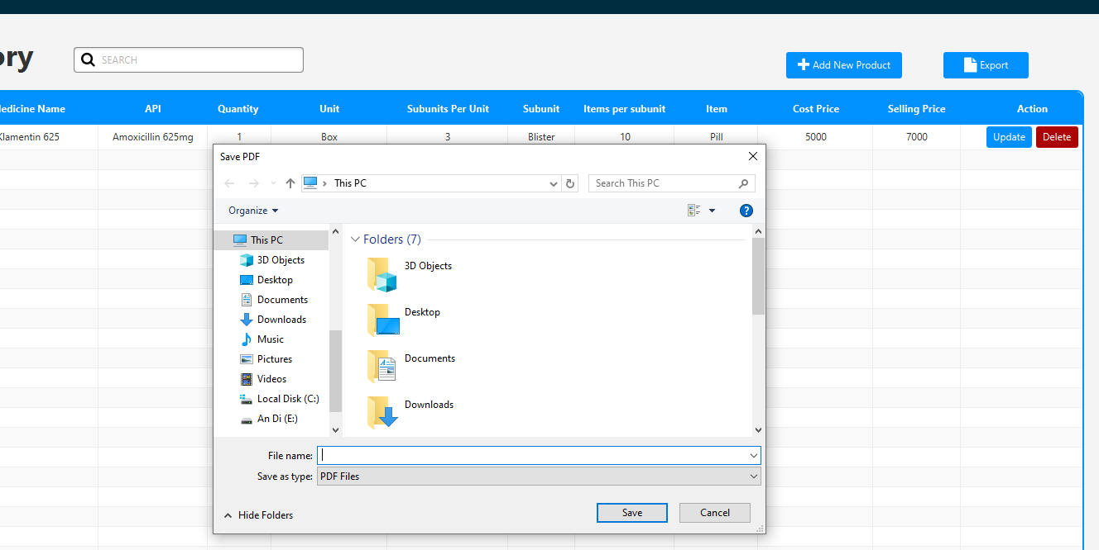
NGUYEN ANH MINH
EXPORT TO PDF

Slide 16
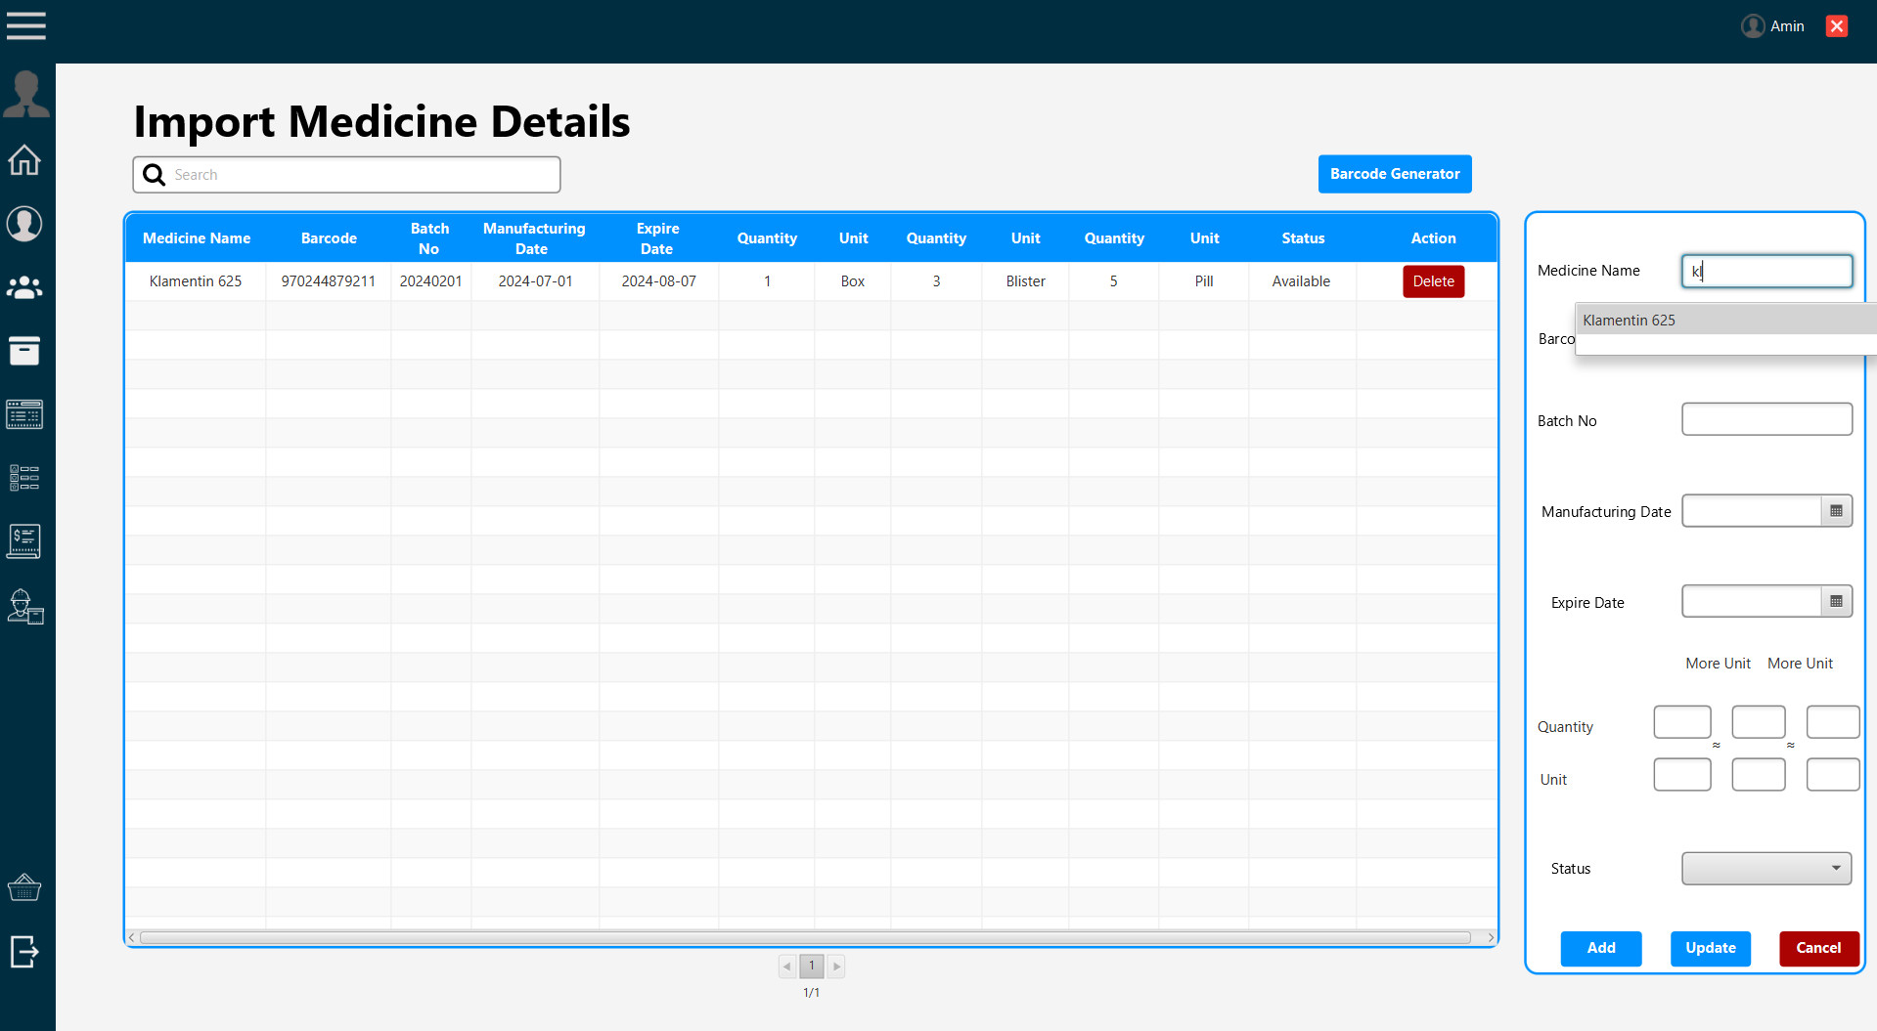
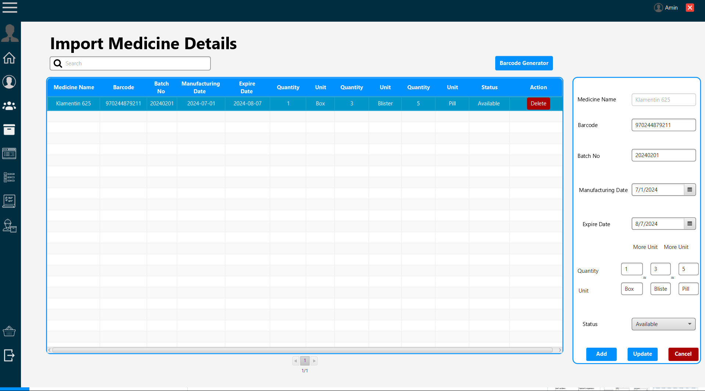
NGUYEN ANH MINH
MEDICINE DETAILS

Slide 17
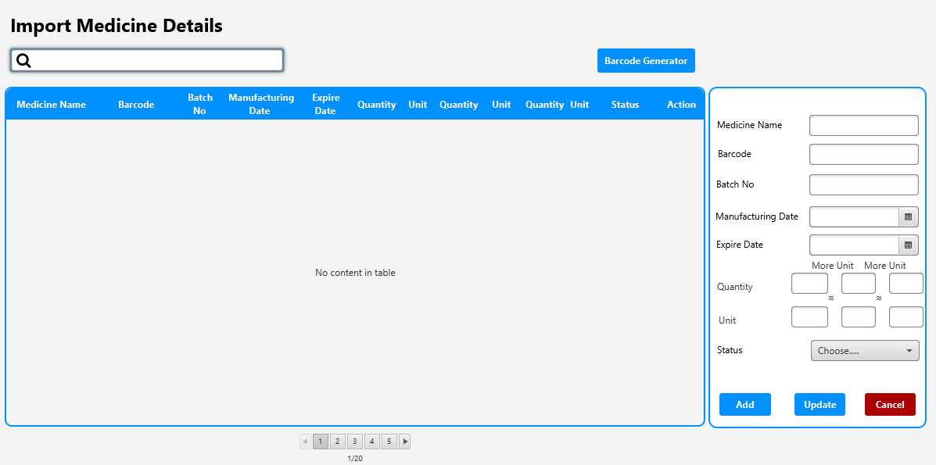
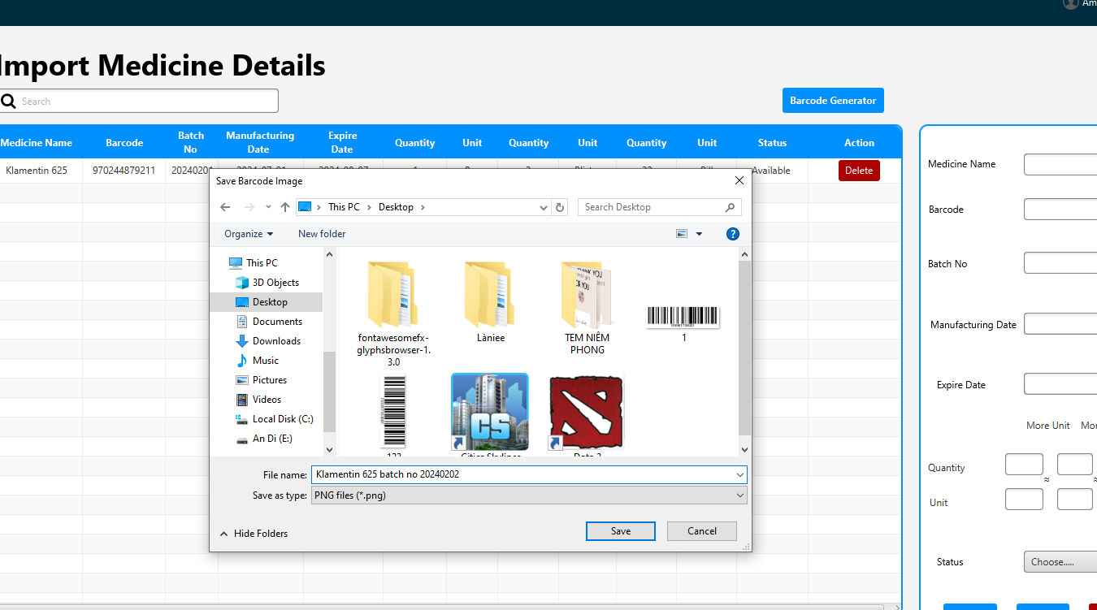

NGUYEN ANH MINH
BARCODE GENERATOR

Slide 18
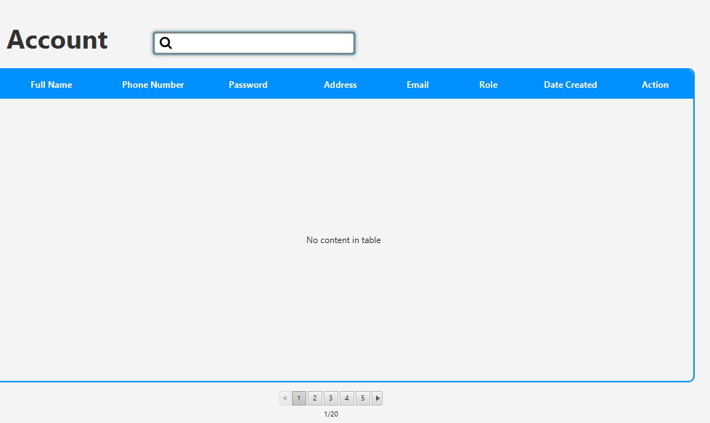
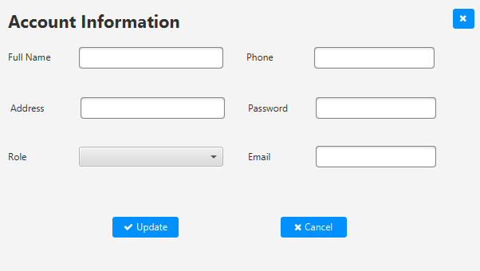
NGUYEN ANH MINH
ACCOUNT

Slide 19
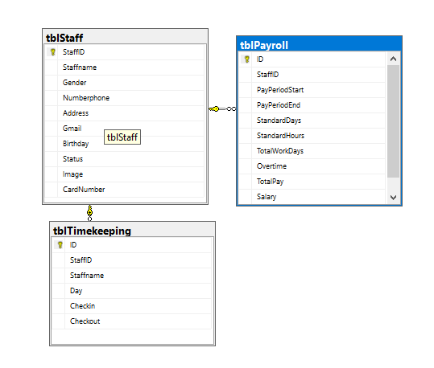
NGUYEN ANH QUAN
DATABASE

Slide 20
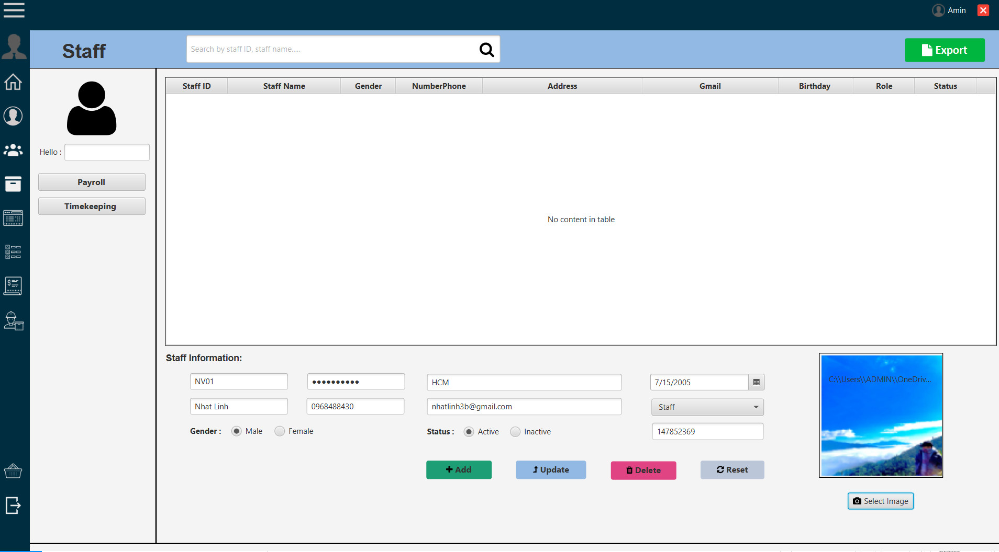
NGUYEN ANH QUAN
STAFF

Slide 21
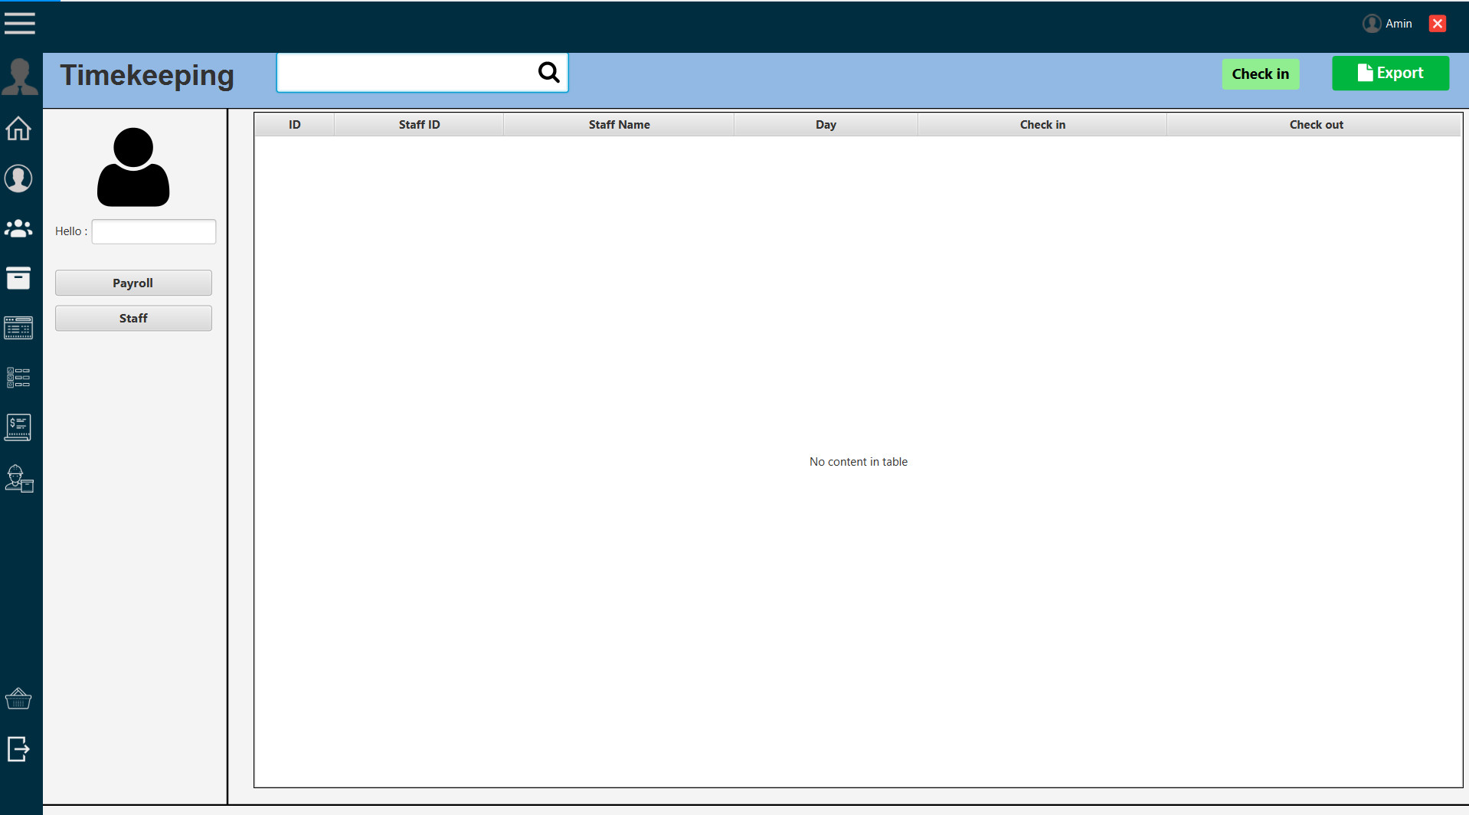
NGUYEN ANH QUAN
TIMEKEEPING

Slide 22
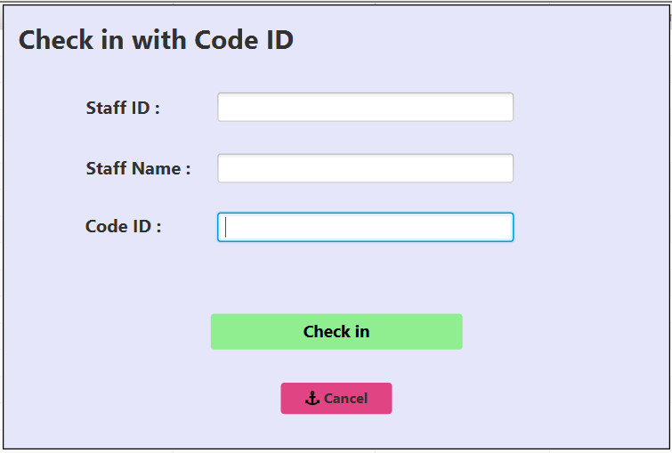
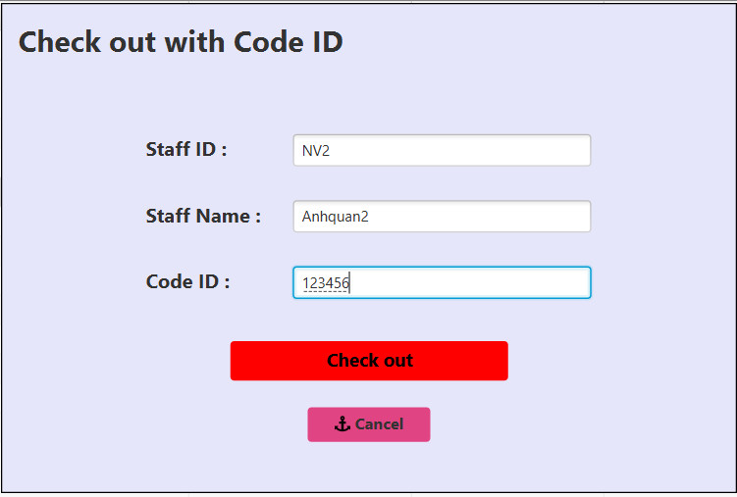
NGUYEN ANH QUAN
TIMEKEEPING

Slide 23
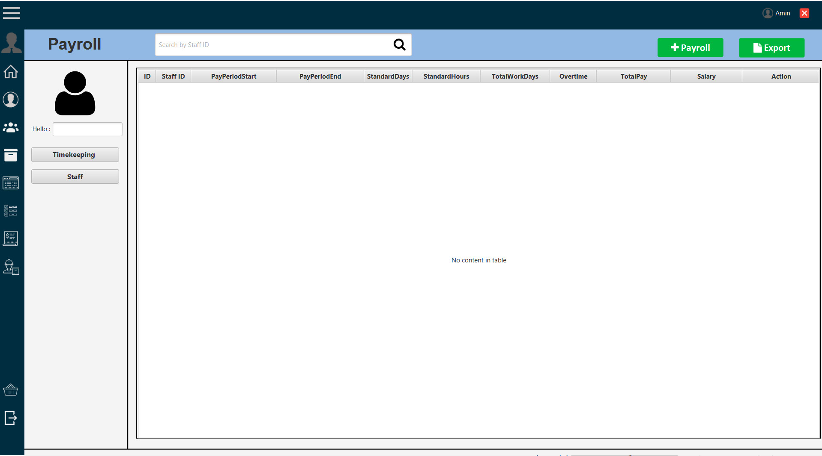
NGUYEN ANH QUAN
PAYROLL

Slide 24
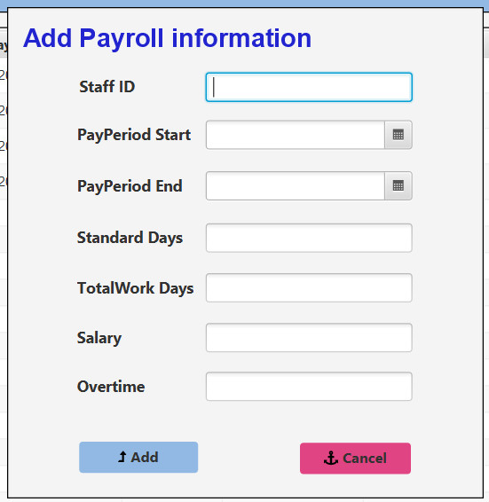
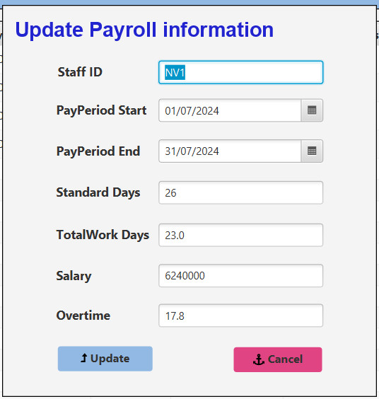
NGUYEN ANH QUAN
PAYROLL

Slide 25
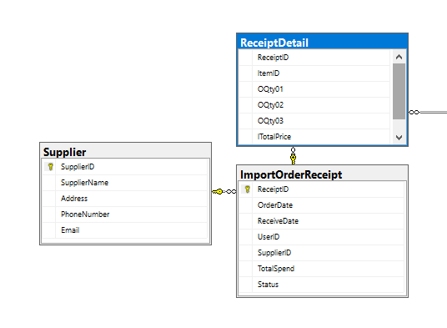
DOAN DUC DO
DATABASE

Slide 26
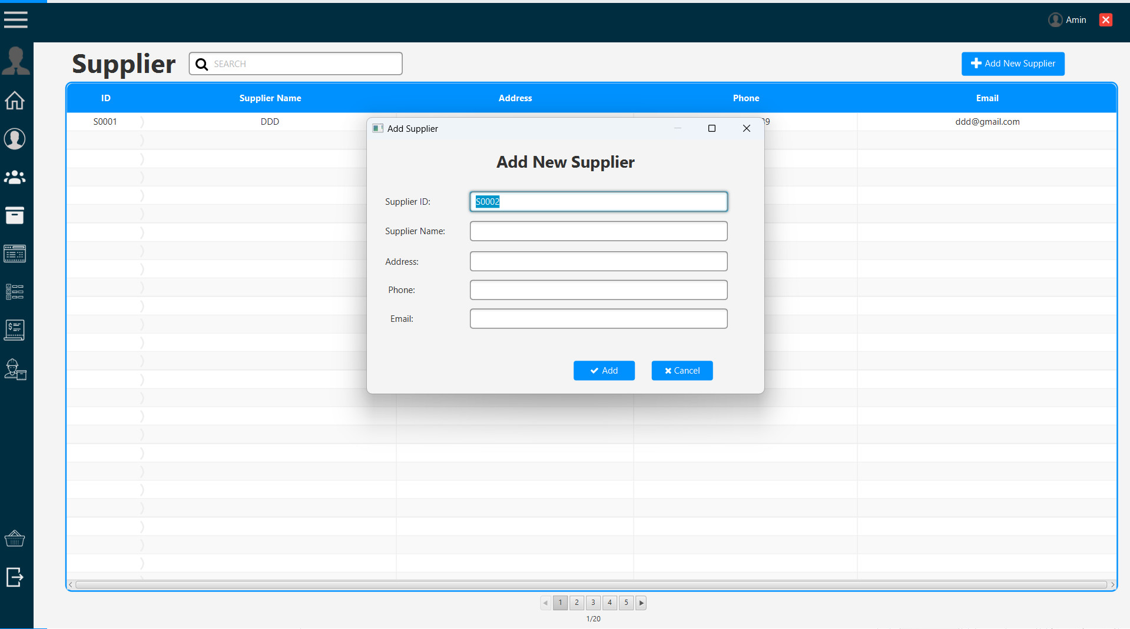
DOAN DUC DO
SUPPLIER

Slide 27
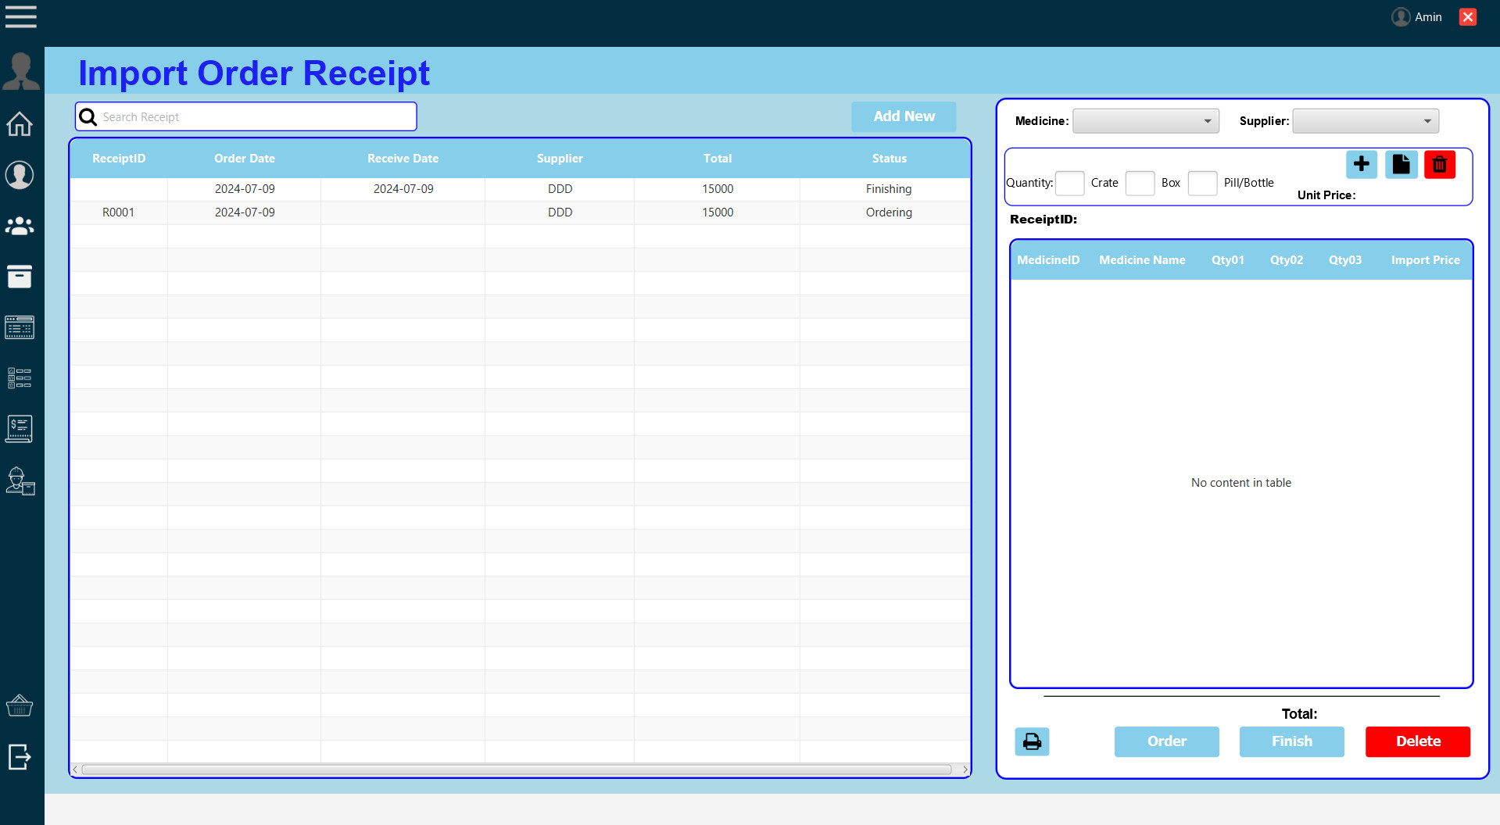
DOAN DUC DO
IMPORT ORDER RECEIPT

Slide 28
TASKSHEET REVIEW
Project: Pharmacy | Date of preparation of activity plan:
Code Part | Main Coder | Supporter | status
Login | Hoang Gia Huy | N/A | Completed
Register | Hoang Gia Huy | N/A | Completed
Forgot Password | Hoang Gia Huy | N/A | Completed
Email | Hoang Gia Huy | Nguyen Anh Minh | Completed
Admin Dashboard | Tran Nhat Linh | N/A | Completed
Staff Dashboard | Tran Nhat Linh | N/A | Completed
Order Transaction | Tran Nhat Linh | N/A | Completed
Category | Nguyen Anh Minh | N/A | Completed
Import Medicine Details | Nguyen Anh Minh | N/A | Completed

Slide 29
TASKSHEET REVIEW
Project: Pharmacy |  | Date of preparation of activity plan:
Code Part | Main Coder | Supporter | status
Import Order Receipt | Doan Duc Do | N/A | Completed
Supplier | Doan Duc Do | N/A | Completed
Account | Nguyen Anh Minh | N/A | Completed
Export PDF | Nguyen Anh Minh | N/A | Completed
Staff | Nguyen Anh Quan | N/A | Completed

Slide 30
TASKSHEET REVIEW
Project: Pharmacy |  | Date of preparation of activity plan:
Code Part | Main Coder | Supporter | status
Payroll | Nguyen Anh Quan | N/A | Completed
Timekeeping | Nguyen Anh Quan | N/A | Completed
Check in-out | Nguyen Anh Quan | Nguyen Anh Minh | Completed
Search | Nguyen Anh Quan & Nguyen Anh Minh & Tran Nhat Linh | N/A | Completed
Customer | Tran Nhat Linh | N/A | Completed
Review |  | Signature of instructor

